Slide 1
A Detailed Look in to Energy Consumption and Pollution Related Deaths
Presentation by PollutionSolvers - Hsueh-Yi Lu, Ali Can Mutlu, Zhon Yang

Slide 2
Data Set Information -
Data taken from Kaggle
2016 being the main year
Main features: Nitrogen, GDP, Death per 100,000 people, Indoor Air Pollution, Outdoor Ozone Pollution, Outdoor Particulate Matter

Slide 3
Dataset Summary
data_health: 2.12_Health_systems.csv
Source: Kaggle
Variables:
Country_Region: Qualitative,Categorical Completeness_of_birth_reg_2009-18: Numerical,Continuous
World_Bank_Name : Qualitative,Categorical per_capita_exp_PPP_2016: Numerical,Continuous
Health_exp_pct_GDP_2016 : Numerical,Continuous External_health_exp_pct_2016: Numerical,Continuous
Health_exp_public_pct_2016 : Numerical,Continuous Physicians_per_1000_2009-18: Numerical,Continuous
Health_exp_out_of_pocket_pct_2016 : Numerical,Continuous Nurse_midwife_per_1000_2009-18: Numerical,Continuous
Health_exp_per_capita_USD_2016 : Numerical,Continuous Specialist_surgical_per_1000_2008-18: Numerical,Continuous

Slide 4
Dataset Summary
data_clean: cleanFuelAndTech.csv
Source: Kaggle
Variables:
Location: Qualitative,Categorical
Indicator: Qualitative,Categorical
Period: Numerical, Categorical
First Tooltip: Numerical,Continuous

Slide 5
Dataset Summary
data_pollution: death-rates-from-air-pollution.csv
Source: Kaggle
Variables:
Entity: Qualitative,Categorical
Code: Qualitative,Categorical
Year: Numerical, Categorical
Air pollution (total) (deaths per 100,000): Numerical,Continuous
Indoor air pollution (deaths per 100,000):Numerical,Continuous
Outdoor particulate matter (deaths per 100,000):Numerical,Continuous
Outdoor ozone pollution (deaths per 100,000):Numerical,Continuous

Slide 6
Dataset Summary
data_GDP: Country_wise_GDP_from_1994_to_2017.csv
Source: Kaggle
Variables:
Country: Qualitative,Categorical Population: Numerical,Continuous
Year: Numerical, Categorical Pop. change (%): Numerical,Continuous
GDP (in USD): Numerical,Continuous GDP Real (in USD):Numerical,Continuous
GDP change (%):Numerical,Continuous
GDP per capita (in USD):Numerical,Continuous

Slide 7
Dataset Summary
data_energy: Percentage_of_Energy_Consumption_by_Country.csv
Source: Kaggle
Variables:
Country: Qualitative,Categorical Hydro Generation – TWh:Numerical,Continuous
Code: Qualitative,Categorical Nuclear Generation – TWh: Numerical,Continuous
Year: Numerical, Categorical Solar Generation – TWh: Numerical,Continuous
Coal Consumption - EJ :Numerical,Continuous Wind Generation –TWh: Numerical,Continuous
Gas Consumption - EJ Numerical,Continuous Oil Consumption – EJ: Numerical,Continuous
Geo Biomass Other - TWh :Numerical,Continuous

Slide 8
Data Pre-Processing
class preprocessing():
def indoor2016(self): df1=self.dfselection(self.setf2,self.data_health,'World_Bank_Name') df2=self.dfselection(self.setf2,self.data_clean,'Location') df3=self.dfselection(self.setf2,self.data_pollution,'Entity') df4=self.dfselection(self.setf2,self.data_GDP,'Country') df2=df2[df2['Period']==2016] df3=df3[df3['Year']==2016] df4=df4[df4['Year']==2016] df1=df1.rename(columns={"World_Bank_Name": "Location"}) df3=df3.rename(columns={'Entity':'Location'}) df4=df4.rename(columns={'Country':'Location'}) out=pd.merge(df1,df2,how='outer',on='Location') out=pd.merge(out,df3,how='outer',on="Location") out=pd.merge(out,df4,how='outer',on='Location') out=out.drop(columns='Province_State') return out

Slide 9
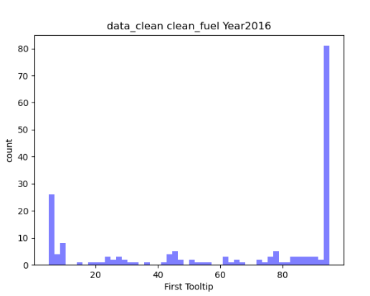
EDA
dc2016 = data_clean_p[data_clean_p['Period'] == 2016] num_bins = 50 # the histogram of the data n, bins, patches = plt.hist(dc2016['First Tooltip'], num_bins, facecolor='blue', alpha=0.5) plt.xlabel('First Tooltip') plt.ylabel('count') plt.title('data_clean clean_fuel Year2016') plt.show()

Slide 10
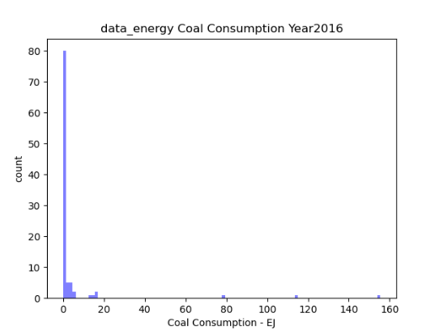
EDA
de2016 = data_energy_p[data_energy_p['Year'] == 2016] num_bins = 100 n, bins, patches = plt.hist(de2016['Coal Consumption - EJ'], num_bins, facecolor='blue', alpha=0.5) plt.xlabel('Coal Consumption - EJ') plt.ylabel('count') plt.title('data_energy Coal Consumption Year2016') plt.show()

Slide 11
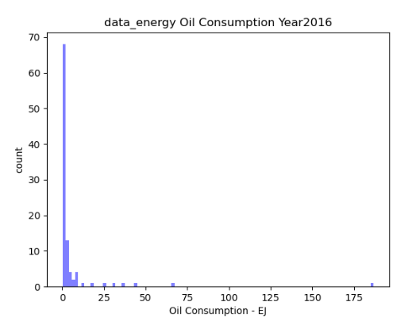
EDA
num_bins = 100 n, bins, patches = plt.hist(de2016['Oil Consumption - EJ'], num_bins, facecolor='blue', alpha=0.5) plt.xlabel('Oil Consumption - EJ') plt.ylabel('count') plt.title('data_energy Oil Consumption Year2016') plt.show()

Slide 12
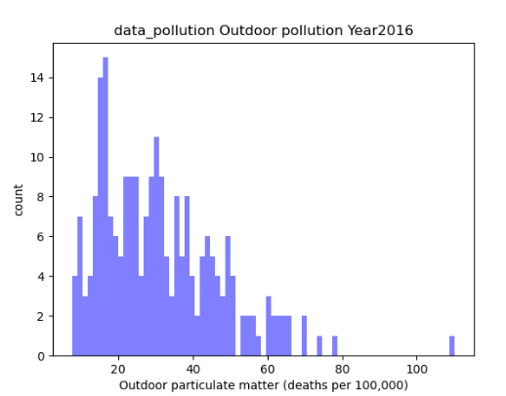
EDA
dp2016 = data_pollution_p[data_pollution_p['Year'] == 2016] num_bins = 75 n, bins, patches = plt.hist(dp2016['Outdoor particulate matter (deaths per 100,000)'], num_bins, facecolor='blue', alpha=0.5) plt.xlabel('Outdoor particulate matter (deaths per 100,000)') plt.ylabel('count') plt.title('data_pollution Outdoor pollution Year2016') plt.show()

Slide 13
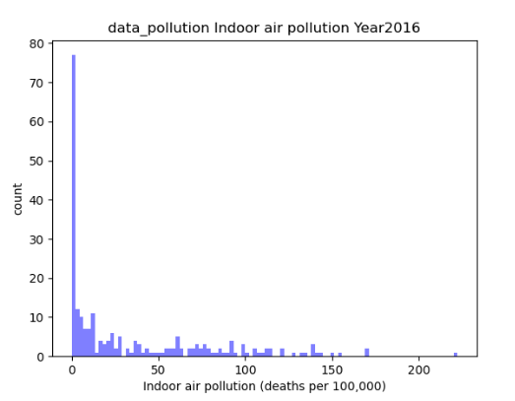
EDA
num_bins = 100 n, bins, patches = plt.hist(dp2016['Indoor air pollution (deaths per 100,000)'], num_bins, facecolor='blue', alpha=0.5) plt.xlabel('Indoor air pollution (deaths per 100,000)') plt.ylabel('count') plt.title('data_pollution Indoor air pollution Year2016') plt.show()

Slide 14
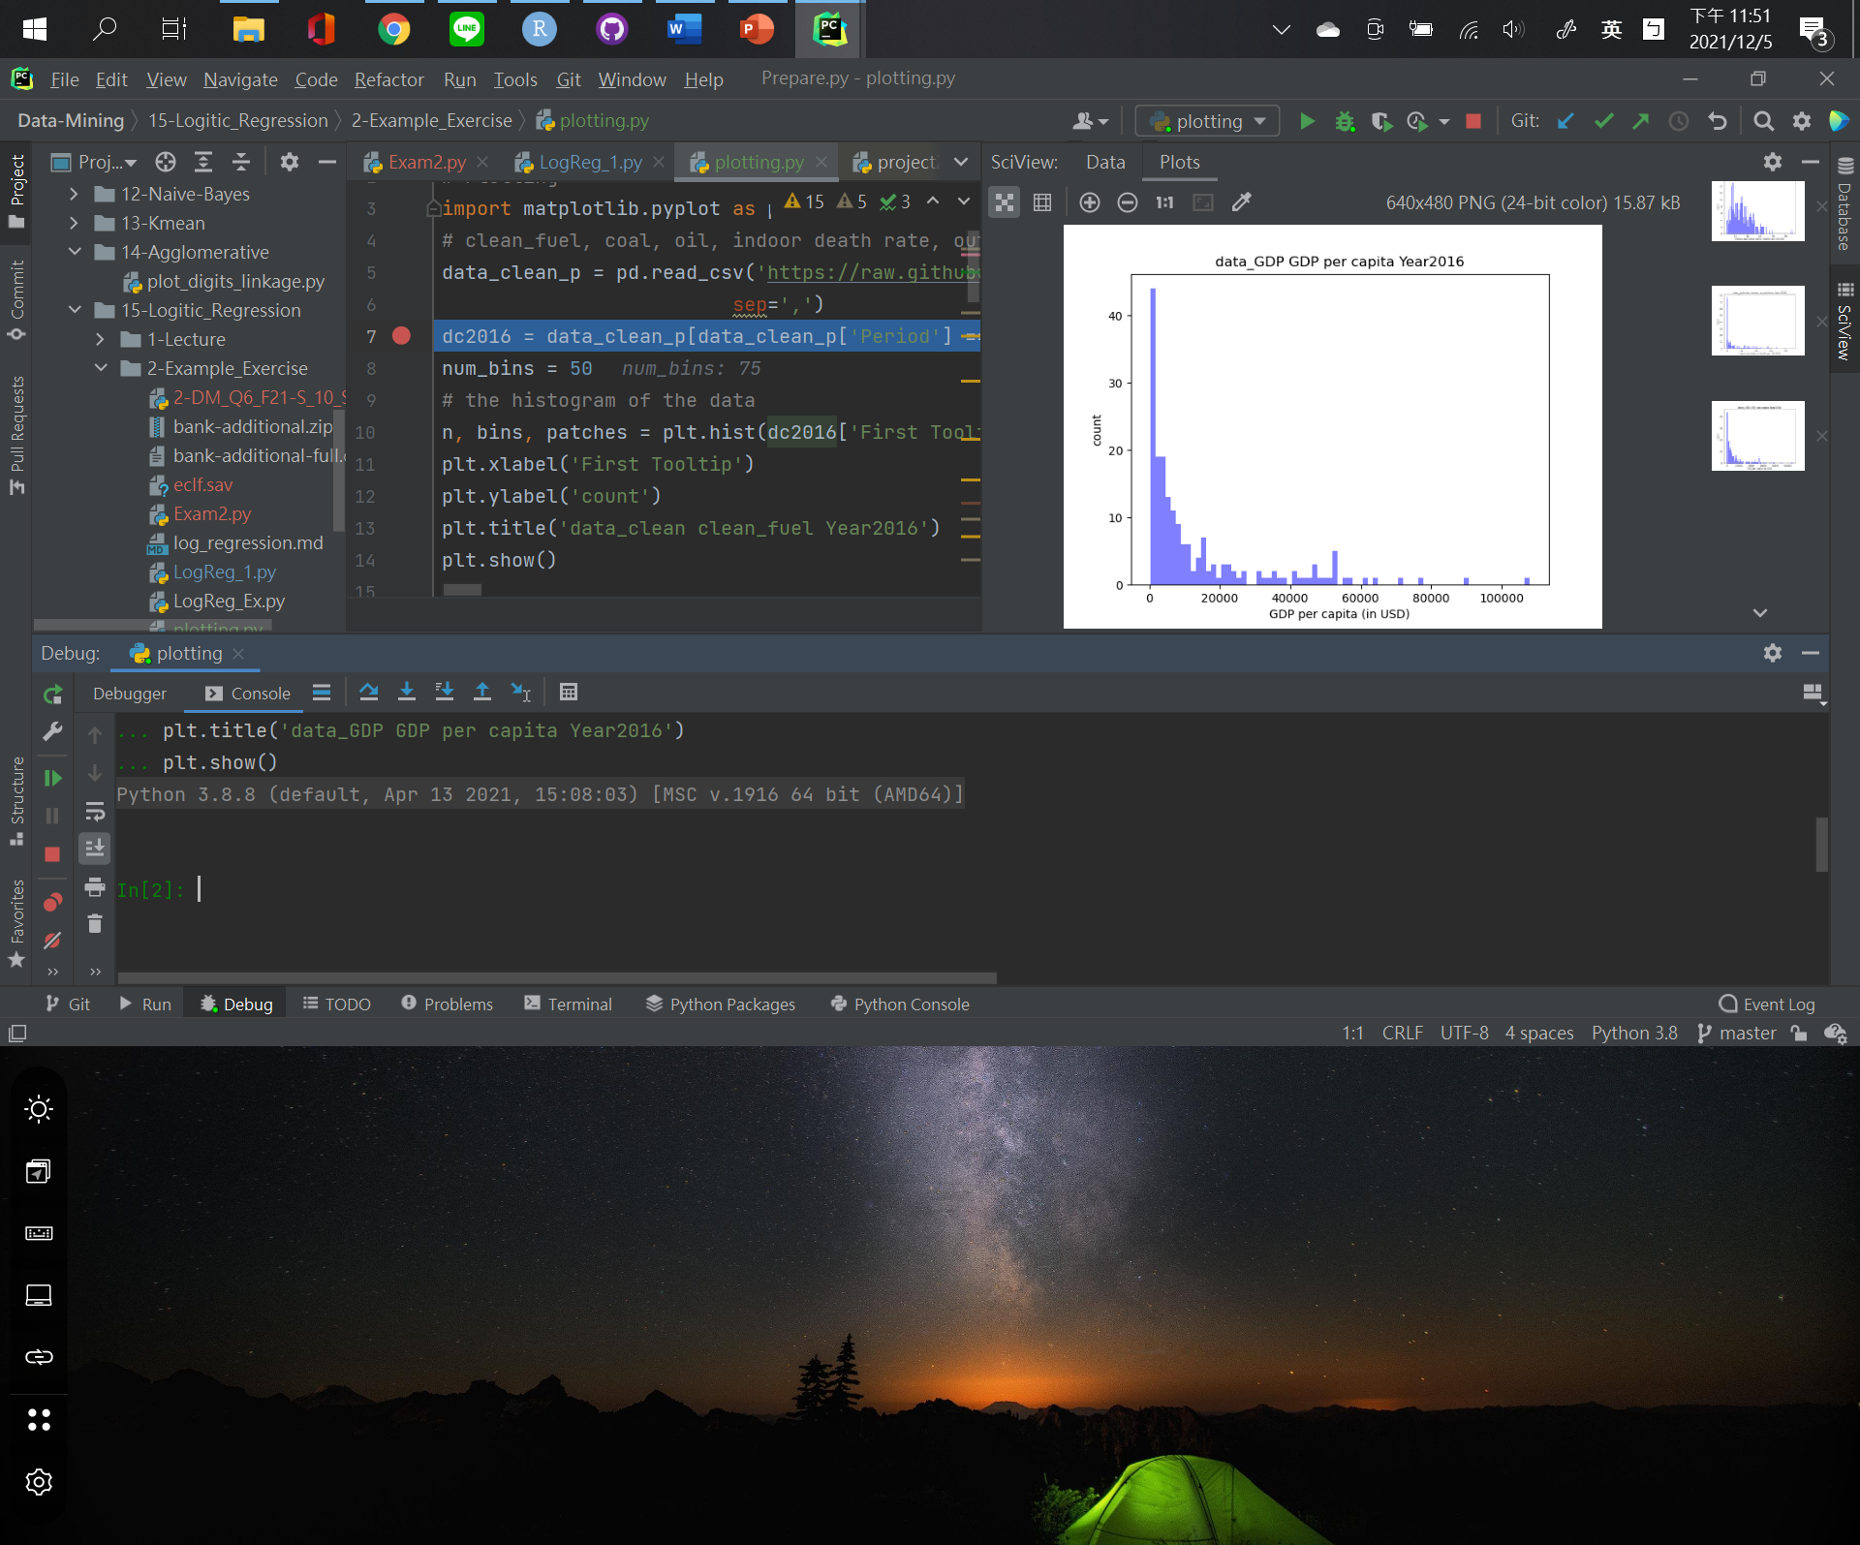
EDA

Slide 15
Hypotheses Testing

Slide 16
Findings

Slide 17
Hypotheses Results

Slide 18
What Next?

